Slide 1
Cascading style sheets (CSS) Presentation 2

Slide 2
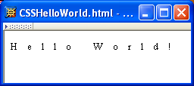
CSS Introduction
A styled HTML document produced by the style sheet style2.css:

Slide 3
CSS Introduction
Note that alternate, user selectable style is not widely supported: firefox 3 and IE 8 do, but IE 6, IE 7 and Chrome don’t.

Slide 4
CSS Introduction
Single document can be displayed on multiple media platforms by tailoring style sheets: This document will be printed differently than it is displayed.

Slide 5
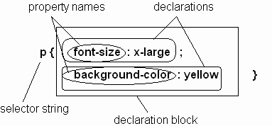
CSS Syntax
Parts of a style rule (or statement)

Slide 6
CSS Syntax: Selector Strings
Single element type:
Multiple element types:
All element types:
Specific elements by id:

Slide 7
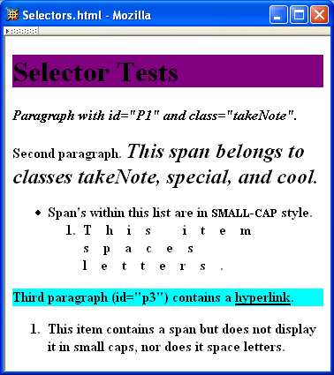
CSS Syntax: Selector Strings

Slide 8
CSS Syntax: Selector Strings
Elements belonging to a style class:
Referencing a style class in HTML:
Elements of a certain type and class:
class selector: begins with a period

Slide 9
CSS Syntax: Selector Strings
Elements belonging to a style class:
Referencing a style class in HTML:
Elements of a certain type and class:
this span belongs to three style classes

Slide 10
CSS Syntax: Selector Strings
Elements belonging to a style class:
Referencing a style class in HTML:
Elements of a certain type and class:
this rule applies only to span’s belonging to class special

Slide 11
CSS Syntax: Selector Strings
Source anchor elements:
Element types that are descendents:
pseudo-classes

Slide 12
CSS Syntax: Selector Strings
Source anchor elements:
Element types that are descendants:
rule applies to li element that is

Slide 13
CSS Syntax: Selector Strings
Source anchor elements:
Element types that are descendants:
rule applies to li element that is part of the content of an ol element

Slide 14
CSS Syntax: Selector Strings
Source anchor elements:
Element types that are descendants:
rule applies to li element that is part of the content of an ol element that is part of the content of a ul element

Slide 15
CSS Syntax
Style rules covered thus far follow ruleset syntax
At-rule is a second type of rule
Reads style rules from specified URL
Must appear at beginning of style sheet
URL relative to style sheet URL

Slide 16
Style Sheets and HTML
Style sheets referenced by link HTML element are called external style sheets
Style sheets can be embedded directly in HTML document using style element
Most HTML elements have style attribute (value is list of style declarations)

Slide 17
Style Sheets and HTML
Rules of thumb:
Use external style sheets to define site-wide style
Prefer style sheets (either external or embedded) to style attributes

Slide 18
CSS Rule Cascade
What if more than one style declaration applies to a property of an element?
The CSS rule cascade determines which style rule’s declaration applies

Slide 19
CSS Rule Cascade
To find the value for an element/property combination, user agents must apply the following sorting order:
1- Find all declarations that apply to the element and property in question, for the target media type. Declarations apply if the associated selector matches the element in question.

Slide 20
CSS Rule Cascade
2- The primary sort of the declarations is by weight and origin: for normal declarations, author style sheets override user style sheets which override the default style sheet. For "!important" declarations, user style sheets override author style sheets which override the default style sheet. "!important" declaration override normal declarations. An imported style sheet has the same origin as the style sheet that imported it.
Five origin/weight levels:
user/important
author/important
author/normal
user/normal
user agent/normal

Slide 21
CSS Rule Cascade
3- The secondary sort is by specificity of selector: more specific selectors will override more general ones. Pseudo-elements and pseudo-classes are counted as normal elements and classes, respectively.
Specificity: If there are two or more CSS conflicting rules that point to the same element, the browser follows some rules to determine which one is more specific and therefore wins out.
Specificity:
style attribute
rule with selector:
ID
class/pseudo-class
descendant/element type
universal
HTML attribute

Slide 22
CSS Rule Cascade
4- Finally, sort by order specified: if two rules have the same weight, origin and specificity, the latter specified wins. Rules in imported style sheets are considered to be before any rules in the style sheet itself.
Conceptually, create one
long style sheet. Later
style rules have higher
priority than earlier rules.

Slide 23
CSS Inheritance
What if no style declaration applies to a property of an element?
Generally, the property value is inherited from the nearest ancestor element that has a value for the property
If no ancestor has a value (or the property does not inherit) then CSS defines an initial value that is used

Slide 24
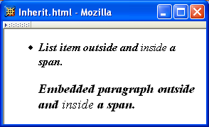
CSS Inheritance

Slide 25
CSS Inheritance
Property values:
Specified: value contained in declaration
Absolute: value can be determined without reference to context (e.g., 2cm)
Relative: value depends on context (e.g., larger)
Computed: absolute representation of relative value (e.g., larger might be 1.2 x parent font size)
Actual: value actually used by browser (e.g., computed value might be rounded)

Slide 26
CSS Inheritance
Most properties inherit computed value
Exception discussed later: line-height
A little thought can usually tell you whether a property inherits or not
Example: height does not inherit

Slide 27
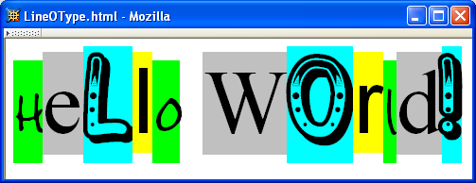
CSS Font Properties
A font is a mapping from code points to glyphs
Glyph (visual representation)
character cell
(content area)

Slide 28
CSS Font Properties
A font is a mapping from code points to glyphs
glyphs do not necessarily stay inside cells!

Slide 29
CSS Font Properties
A font family is a collection of related fonts (typically differ in size, weight, etc.)
font-family property can accept a list of families, including generic font families
first choice font

Slide 30
CSS Font Properties
A font family is a collection of related fonts (typically differ in size, weight, etc.)
font-family property can accept a list of families, including generic font families
second choice font

Slide 31
CSS Font Properties
A font family is a collection of related fonts (typically differ in size, weight, etc.)
font-family property can accept a list of families, including generic font families
generic

Slide 32
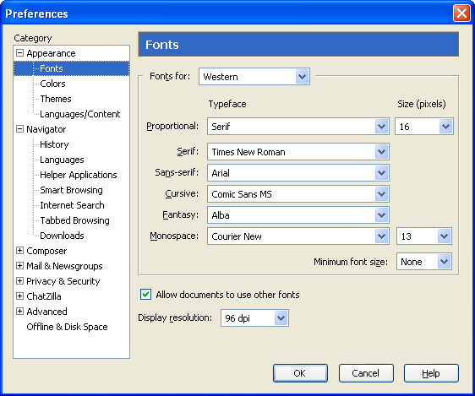
CSS Font Properties
generic
fonts are
system-
specific

Slide 33
CSS Font Properties
Note that most generic font can be easily set on Firefox and Chrome, but such option doesn’t seem to be available on IE 7 and 8. IE will still default to something although maybe not what you had hoped for!

Slide 34
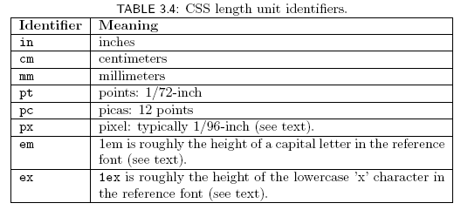
CSS Font Properties
Many properties, such as font-size, have a value that is a CSS length
All CSS length values except 0 need units

Slide 35
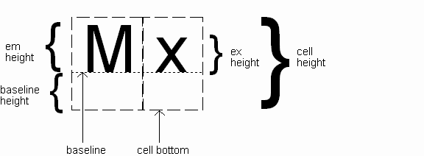
CSS Font Properties
Computed value
of font-size property

Slide 36
CSS Font Properties
Reference font defines em and ex units
Normally, reference font is the font of the element being styled
Exception: Using em/ex to specify value for font-size
parent element’s font is
reference font

Slide 37
CSS Font Properties
Other ways to specify value for font-size:
Percentage (of parent font-size)
Absolute size keyword: xx-small, x-small, small, medium (initial value), large, x-large, xx-large
User agent specific; should differ by ~ 20%
Relative size keyword: smaller, larger
Relative to parent element’s font

Slide 38
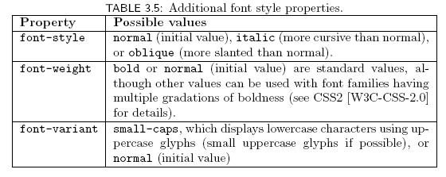
CSS Font Properties

Slide 39

CSS Font Properties
Text is rendered using line boxes
Height of line box given by line-height
Initial value: normal (i.e., cell height; relationship with em height is font-specific)
Other values (following are equivalent):

Slide 40
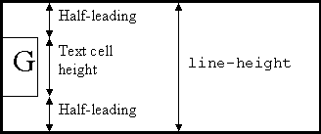
CSS Font Properties
When line-height is greater than cell height:
Inheritance of line-height:
Specified value if normal or unit-less number
Computed value otherwise

Slide 41
CSS Font Properties
font shortcut property:

Slide 42
CSS Font Properties
font shortcut property:
Initial values used if no value specified in font
property list (that is, potentially reset)

Slide 43
CSS Font Properties
font shortcut property:
specifying line-height (here, twice cell height)
any order
size and family required,
order-dependent

Slide 44
That’s All for Today

